Slide 1
Challenges for Serverless Native Cloud Applications
Third International Workshop on Serverless Computing
Ben Kehoe
Cloud Robotics Research Scientist
AWS Community Hero
@ben11kehoe
2018-07-02
Notes:
Me
iRobot
Roomba, scale
Serverless prod, 30 svcs

Slide 2
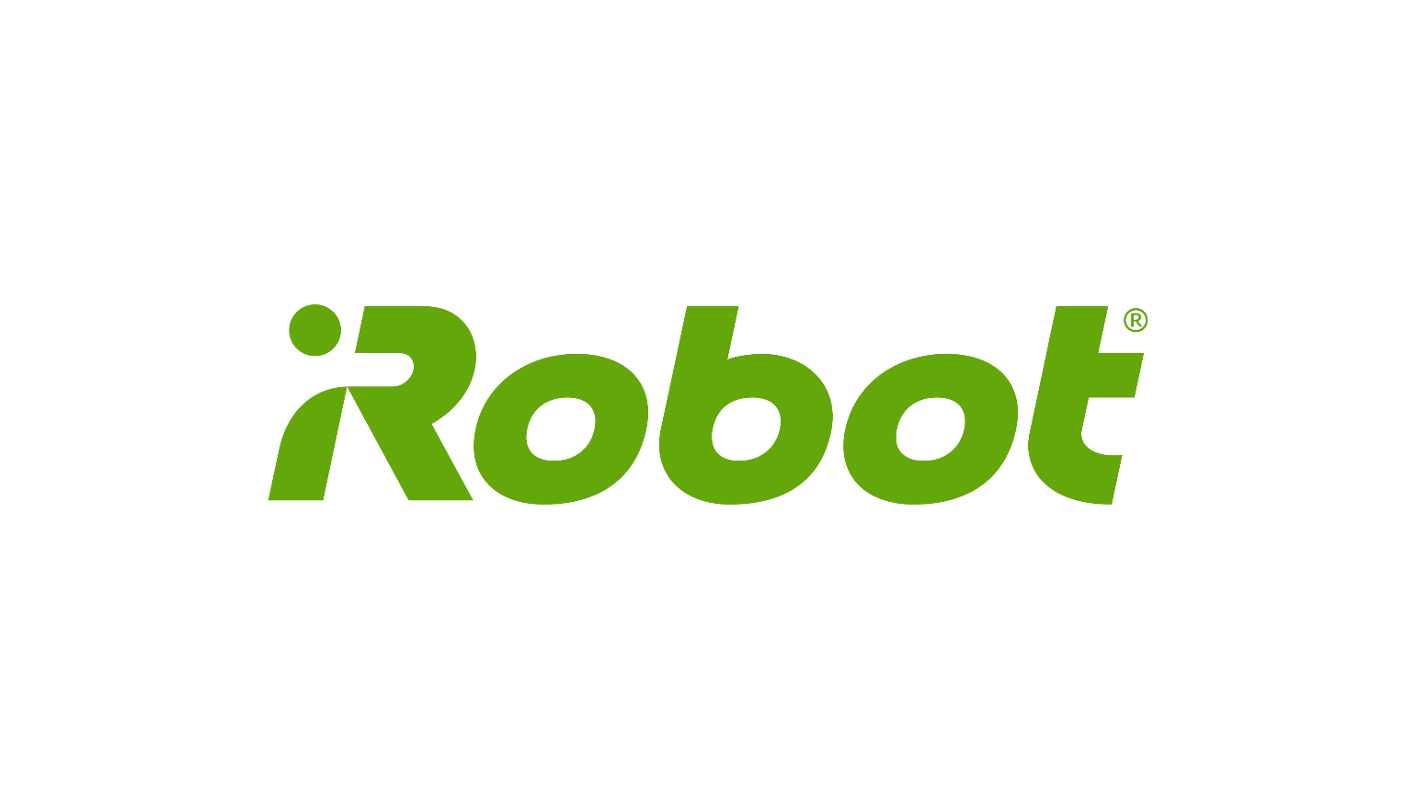

About me
Cloud robotics: Connecting robots to the internet to help them do more and better things
Cloud Robotics Research Scientist at iRobot (since Feb 2015)
PhD in Mechanical Engineering from UC Berkeley, Dec 2014
“Brass”

Slide 3
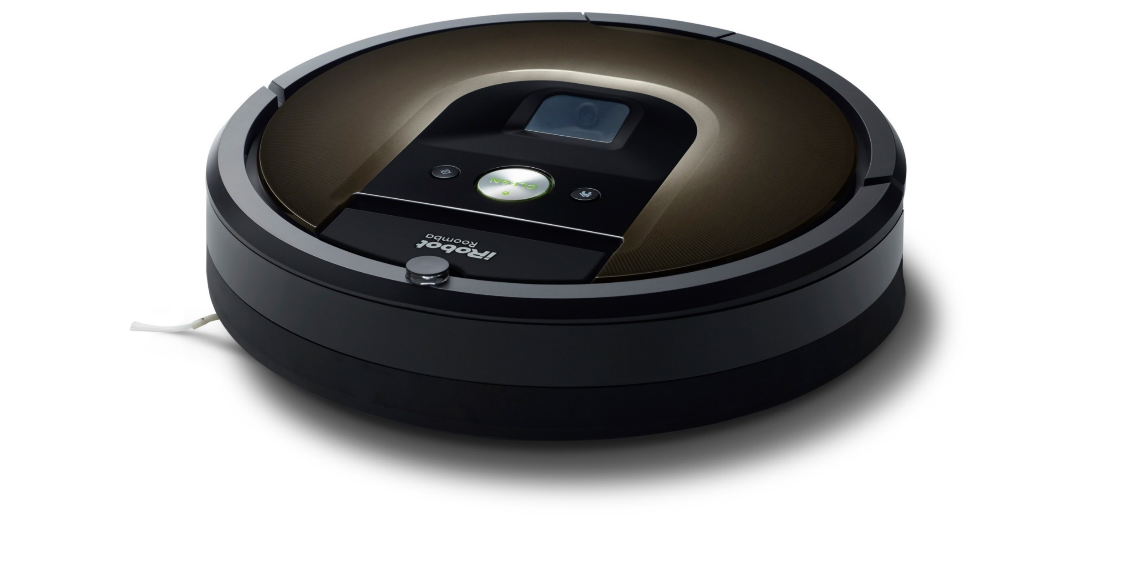
2015
Notes:
980 launch
first connected Roomba

Slide 4
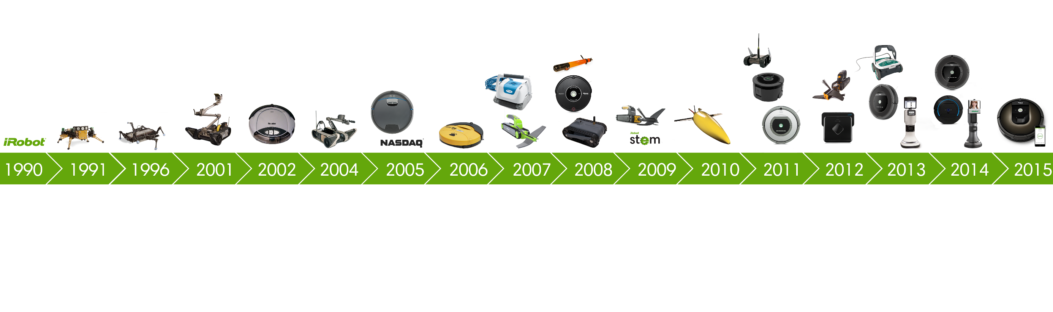

Slide 5
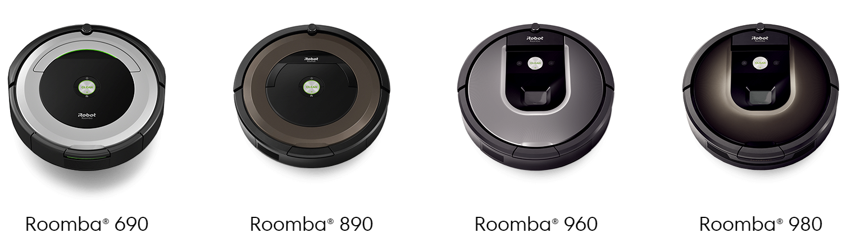
Then
Now

Slide 6
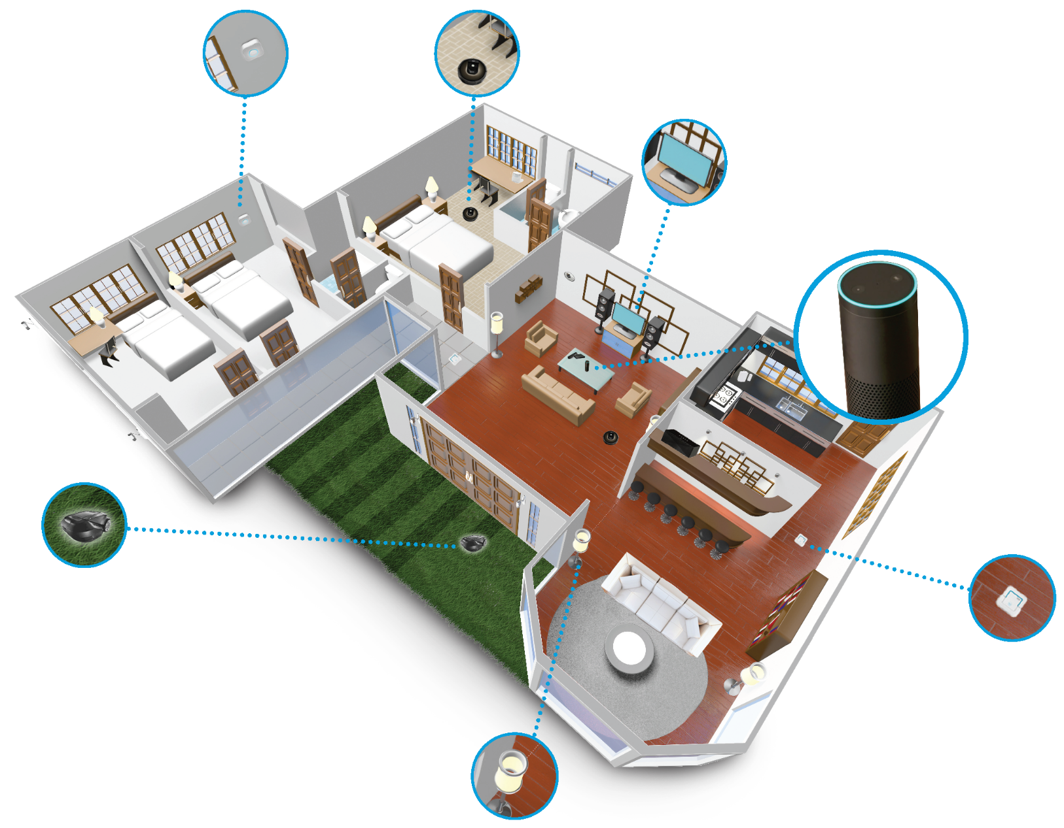
Then
Now
Future
Notes:
More robots
Smart Home
HKC

Slide 7
Notes:
AWS IoT is the connection layer
Other services needed
Depends on how you count (Kinesis Firehose, IAM/STS)
And extras

Slide 8
Why serverless?

Slide 9
The reasons for serverless
What:
Service-full + ephemeral compute
Not always F, not always aaS
Resources billed → resources used
Smaller, more abstract control plane
Why:
Lower cost
Lower operations burden
Faster time to market
Focus on business value

Slide 10

Serverless architecture
Call graph → component graph
Distributed system thinking
Traditionally occurs at system boundaries
Serverless: must be treated systematically
Build robust-by-design systems
Notes:
Good strategy is to go event-based, e.g. CQRS

Slide 11
Before serverless
aka the dark ages
def foo(input):
quux = bar(input.baz)
internalState.quux = quux
def bar(input):
# do work
return result
EC2

Slide 12
Lambda functions
Foo
Bar
def handler(event, context):
# do work
return result
def handler(event, context):
quux = Lambda.Invoke(
'bar',
event['baz'])
DynamoDB.PutItem(
'quux',
quux)
ExternalState
DynamoDB

Slide 13
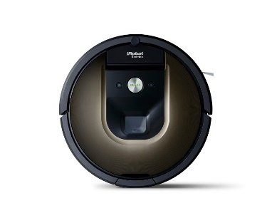
AWS IoT operations
Create Shadow
Permissions
Dead Letter Queue
AWS
IoT
API Gateway
Queues
Robots to
Register
/register
Check
Cert
Queue
Reader
Logging
Lifecycle event
Notes:
registering a robot
example looks complicated

Slide 14
Deployment

Slide 15
Notes:
Red-black entire system
Ok, since you never pay for idle
Scalable in number of services, but not cadence
Two entire systems: how do you switch clients over?

Slide 16
Deployment
Red/black imposes requirements on clients
Blue/green is the direction providers are headed
Existing paradigm:
Blue/green controller is part of your component graph
Update component graph in-place
Controller manages roll-out

Slide 17
API
Function

Slide 18
Function
version
API
Function
router
v1
v2

Slide 19
API
router
API
version
Function
version
Function
router
v1
v1
v2
v2

Slide 20
API
router
API
version
Function
version
v1
v1
v2
v2
Function/code versions must be first-class citizens in infrastructure

Slide 21
A
A
A
B
C1
B
C1
C2
B
C2

Slide 22
D
E1
D
E1
E2
D
E2
???
A
A
A

Slide 23
D
E1
D
E1
E2
D
E2
A
A
A
A

Slide 24
Function
Role
Policy

Slide 25
Function
Policy
v1 allow
v1 deny
both allow
both deny
v1
v1
Role
?
?
?
v2 allow
v2 deny
both allow
both deny
v2
v2
Continuity of role may be necessary
Notes:
Policies could be on versions

Slide 26
Function
Role
Policy
v1 allow
v1 deny
both allow
both deny
v1
v1
v1
v1 allow
v2 allow
both allow
both deny
v2
v2 allow
v2 deny
both allow
both deny
v2
v2

Slide 27
Summing up
Red/black is actually pretty easy for serverless, but harder on the service consumers
Blue/green component graph gets complicated
Existing deployment tools don’t represent intermediate states
Native support for blue/green component graphs is critical

Slide 28
Questions?

